Slide 1
CHAMFER MATCHING, TRACKING, AND OCCLUSION
http://www.gavrila.net/Research/Chamfer_System/chamfer_system.html
The Chamfer System offers a high-performance solution to shape-based object detection. It covers the detection of arbitrary-shaped objects, whether parametrized (e.g. rectangles and ellipses) or not (e.g. pedestrian outlines).
Because the system learns shape distributions of target objects from examples, it is flexible and easily adaptable, without reprogramming. Its pixel-based correlation approach eliminates the need for error-prone contour segmentation.
A major advantage is the hierarchical approach of the system (in both shape and transformation space); it results in substantial efficiency gains compared to an equivalent brute-force template matching method. Speed-ups of several orders of magnitude have been measured.
Applications, from object detection on-board smart vehicles, to inspection tasks in industrial vision, and target recognition for the military environment.

Slide 2
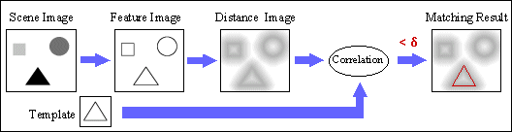
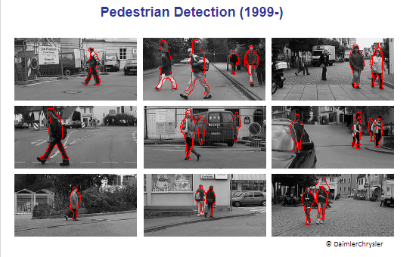
CHAMFER MATCHING, TRACKING, AND OCCLUSION

Slide 3
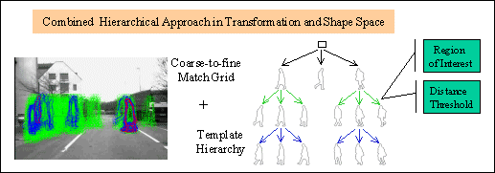
CHAMFER MATCHING, TRACKING, AND OCCLUSION

Slide 4
CHAMFER MATCHING, TRACKING, AND OCCLUSION
The basic idea behind chamfer matching relates to the process of matching
objects to templates via their boundaries—a strategy that should be much less computation intensive than matching via whole object regions.
However, since this would not give much indication of a potential match until very close to the match position, some means is required of making the approach to a match far smoother.
This should also permit substantial speedup of the process by employing
a hierarchical coarse-to-fine search

Slide 5
To achieve a smoother transition, edge points in the image are first located, and then a distance function image is generated,starting with the edge points, which are initialized to zero distance values.
Application of the template, also in the form of edge points, will ideally yield a zero sum (of image distance function values) along the template points:
this will rise to a higher value when the template is misplaced or the shape of the object is distorted, corresponding to the sum of distances of each image point from the ideal position.

Slide 6
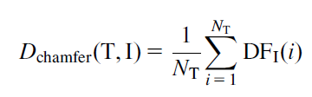
Taking the distance function as DFI(i), we can express the degree of match by the average “chamfer” distance, i.e. the average distance from each edge point to the nearest edge point in the template T:
where NT is the number of edge points within the template.
Dchamfer(T,I);
is actually a dissimilarity measure, having a value of zero for a perfect match.

Slide 7
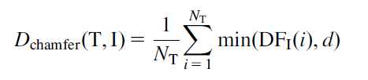
As it stands, this approach is limited because any outliers (caused by occlusion or segmentation errors, for example) will lead to substantial matching problems.
To limit this problem, used a truncated distance for matching:

Slide 8

with a suitable empirical value of d. On the other hand, Gavrila (1998) applied an order-based method for limiting the number of interfering distance function values, taking the kth of the ordered values (1 to NT) as the solution value:

Slide 9

is worth observing that when K equal to NT

Slide 10

limitations
The chamfer matching technique were compensated by using segmentation information
This meant obtaining a similarity function from the chamfer distance (which is a dissimilarity measure), and then combining with a Bhattacharyya coefficient representing overlap with the hypothesized segmentation SegI(i) to produce an overall
similarity measure:

